Slide 1
Android Developer Fundamentals
Hello World
Lesson 1

Slide 2


1.1 Create Your First Android App

Slide 3
Contents
Android Studio
Creating "Hello World" app in Android Studio
Basic app development workﬂow with Android Studio
Running apps on virtual and physical devices

Slide 4
Prerequisites
Java Programming Language
Object-oriented programming
XML - properties / attributes
Using an IDE for development and debugging

Slide 5
Android Studio

Slide 6
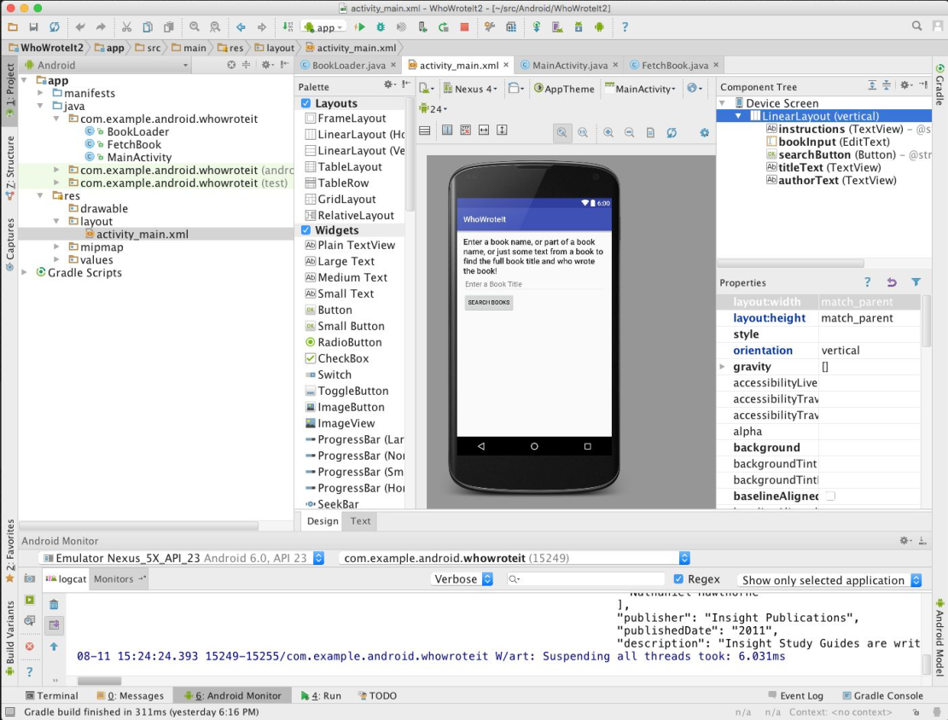
What is Android Studio?
Android IDE
Project structure
Templates
Layout Editor
Testing tools
Gradle-based build
Log Console
Debugger
Monitors
Emulators

Slide 7
Installation Overview
Mac, Windows, or Linux
Requires Java Development Kit (JDK) 1.7 or better from Oracle Java SE downloads page
Set JAVA_HOME to JDK installation location
Download and install Android Studio from http://developer.android.com/sdk/index.html
See 1.1 P Install Android Studio for details
This work is licensed under a Creative Commons Attribution-NonCommercial 4.0 International License

Slide 8
Creating Your First Android App
This work is licensed under a Creative Commons Attribution-NonCommercial 4.0 International License

Slide 9
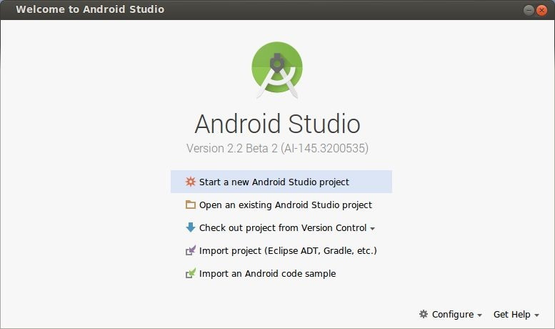

Start Android Studio
This work is licensed under a Creative Commons Attribution-NonCommercial 4.0 International License

Slide 10
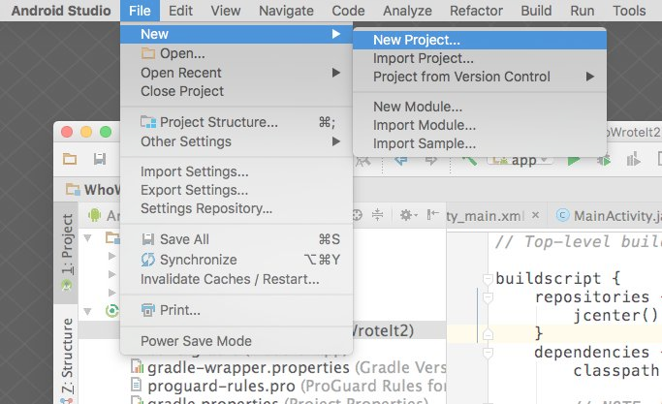
Create a project inside Android Studio
This work is licensed under a Creative Commons Attribution-NonCommercial 4.0 International License

Slide 11
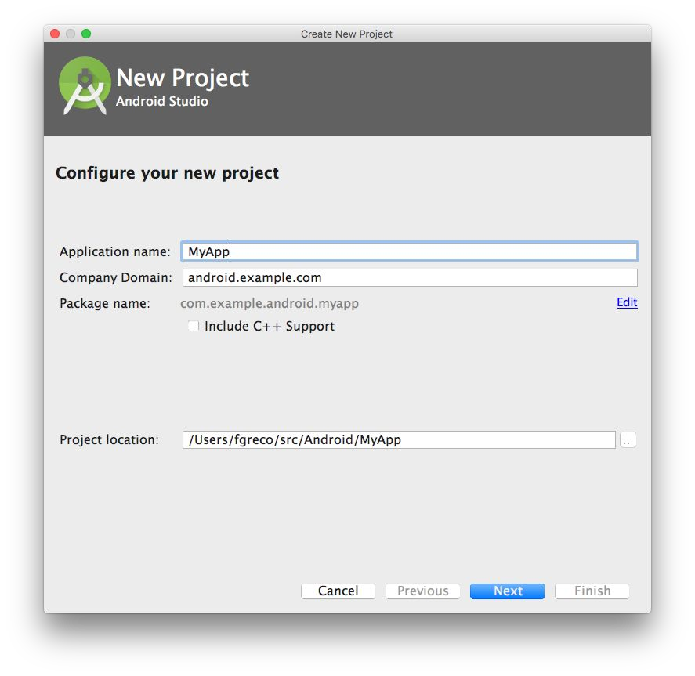
Name your app
This work is licensed under a Creative Commons Attribution-NonCommercial 4.0 International License

Slide 12
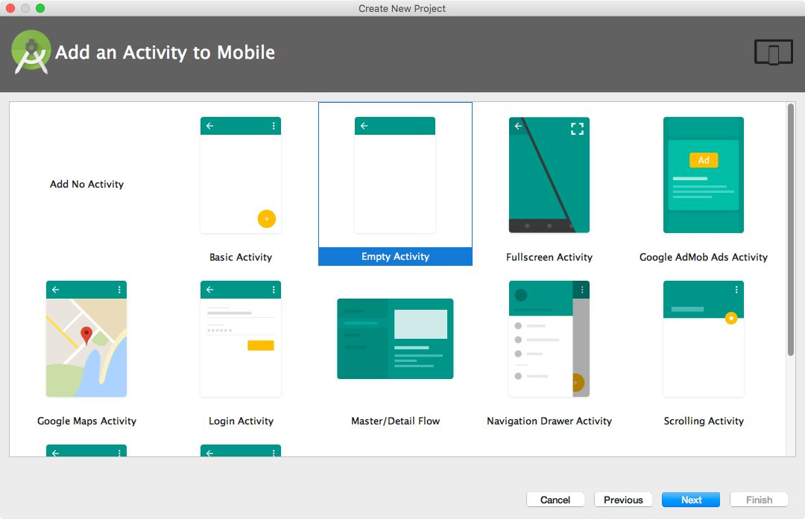
Pick activity template
Choose templates for common activities, such as maps or navigation drawers.
Pick Empty Activity or Basic Activity for simple and custom activities.
This work is licensed under a Creative Commons Attribution-NonCommercial 4.0 International License

Slide 13
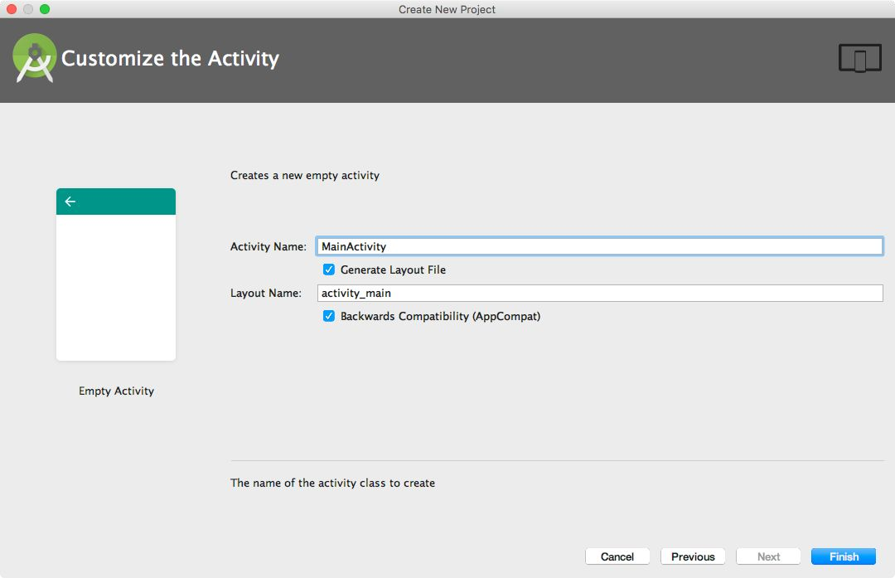
Name your activity
Good practice to name main activity MainActivity and activity_main layout
Use AppCompat
Generating layout file is convenient
This work is licensed under a Creative Commons Attribution-NonCommercial 4.0 International License

Slide 14
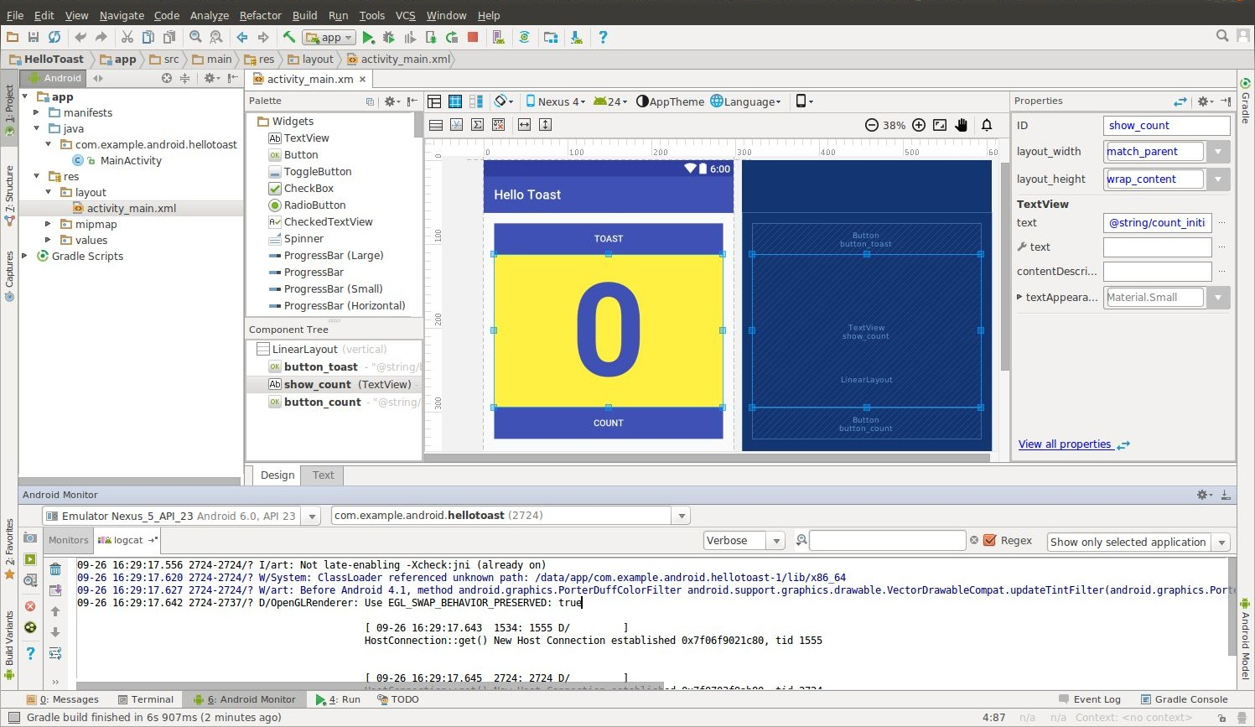
Android Studio Panes
Layout Editor
Project Files
Android Monitors: logcat: log messages
This work is licensed under a Creative Commons Attribution-NonCommercial 4.0 International License

Slide 15
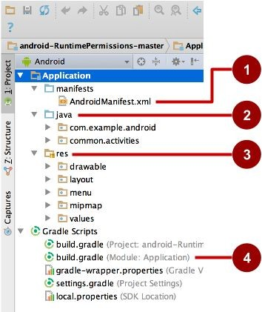
Project folders
manifests—Android Manifest file - description of app read by the Android runtime
java—Java source code packages
res—Resources (XML) - layout, strings, images, dimensions, colors...
build.gradle—Gradle build files
This work is licensed under a Creative Commons Attribution-NonCommercial 4.0 International License

Slide 16
Gradle build system
Modern build subsystem in Android Studio
Three build.gradle:
project
module
settings
Typically not necessary to know low-level Gradle details
Learn more about gradle at https://gradle.org/
This work is licensed under a Creative Commons Attribution-NonCommercial 4.0 International License

Slide 17
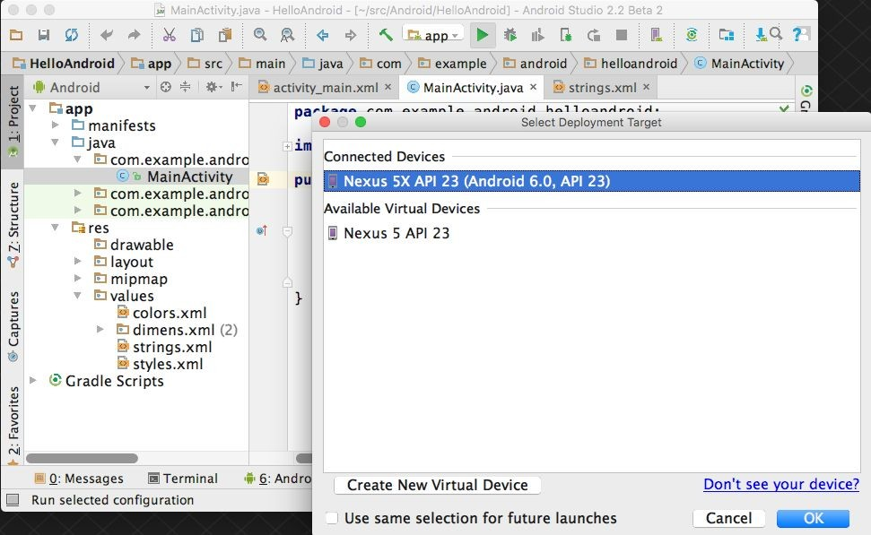


Run your app
Run
Select virtual or physical
device
OK
This work is licensed under a Creative Commons Attribution-NonCommercial 4.0 International License
17

Slide 18
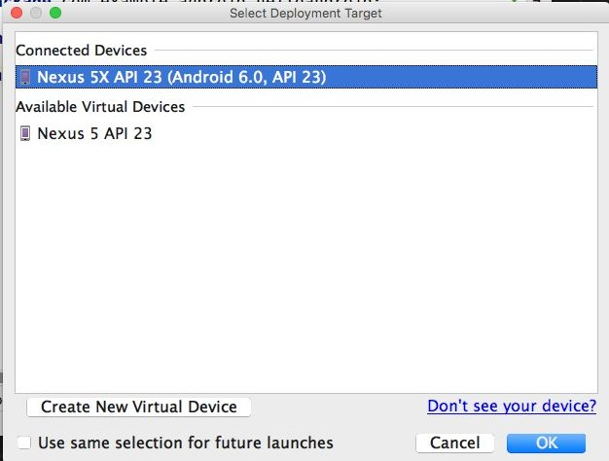
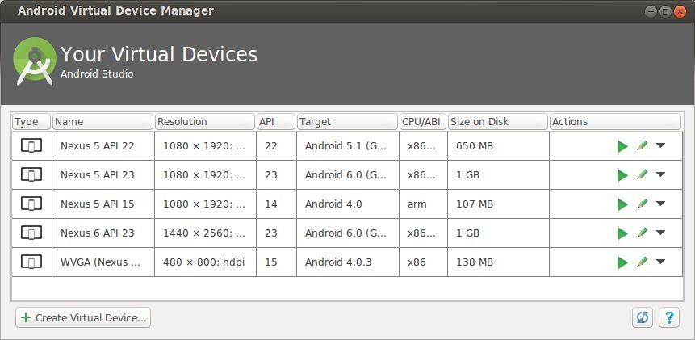
Create a virtual device
Use emulators to test app on different versions of Android and form factors.
Tools > Android > AVD Manager or:
This work is licensed under a Creative Commons Attribution-NonCommercial 4.0 International License

Slide 19
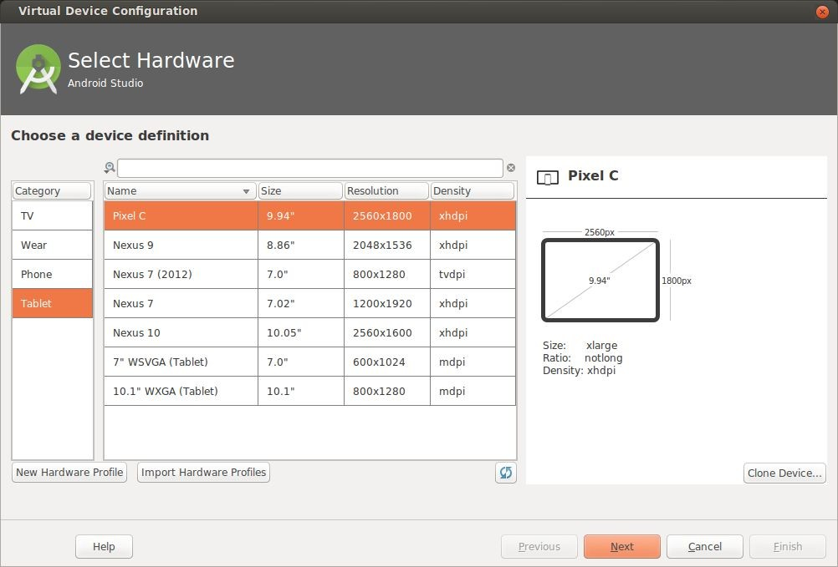
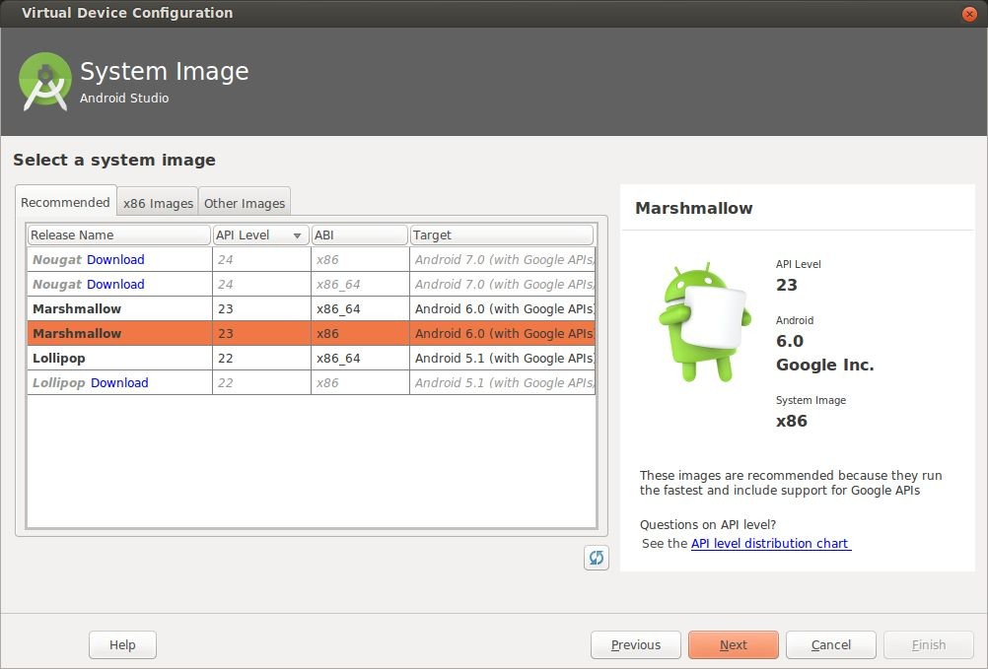
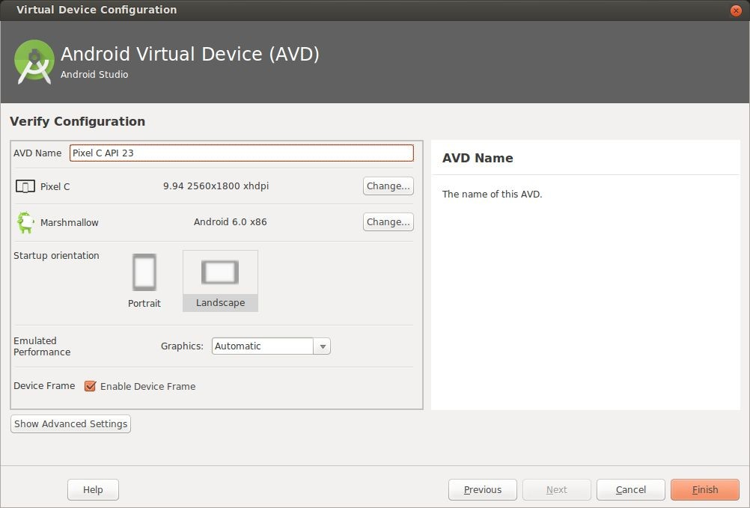
Conﬁgure virtual device
1. Choose hardware
2. Select Android Version
3. Finalize
This work is licensed under a Creative Commons Attribution-NonCommercial 4.0 International License

Slide 20
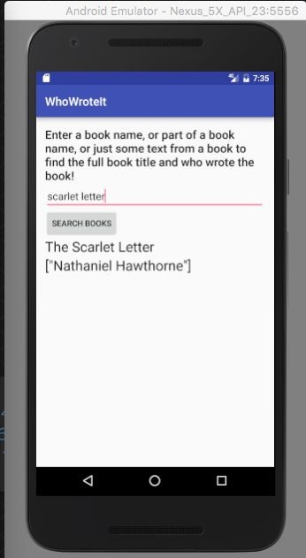

Run on a virtual device
This work is licensed under a Creative Commons Attribution-NonCommercial 4.0 International License

Slide 21
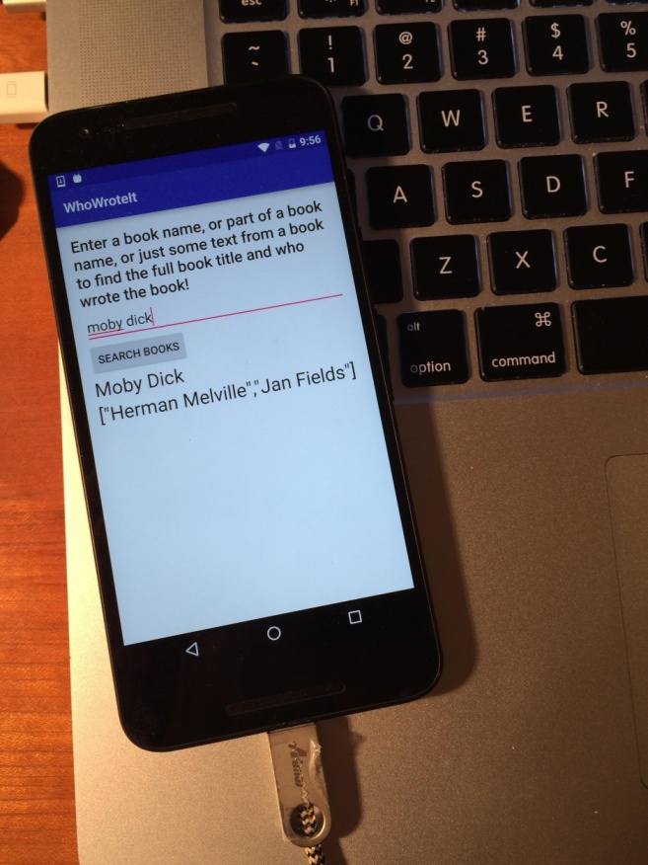
Run on a physical device
Turn on Developer Options:
Settings > About phone
Tap Build number seven times
Turn on USB Debugging
Settings > Developer Options > USB Debugging
Connect phone to computer with cable
Windows/Linux additional setup:
Using Hardware Devices
Windows drivers:
OEM USB Drivers

Slide 22
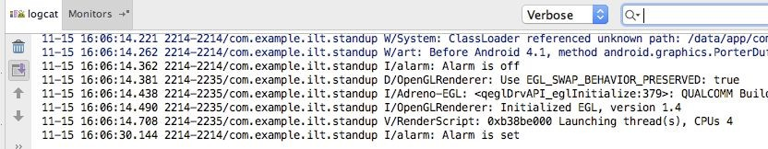
Get feedback as your app runs
As the app runs, Android Monitor logcat shows information
You can add logging statements to your app that will show up in logcat.

Slide 23
Logging
import android.util.Log;
// Use class name as tag
private static final String TAG = MainActivity.class.getSimpleName();
// Show message in Android Monitor, logcat pane
// Log.<log-level>(TAG, "Message"); Log.d(TAG, “Creating the URI…”);

Slide 24
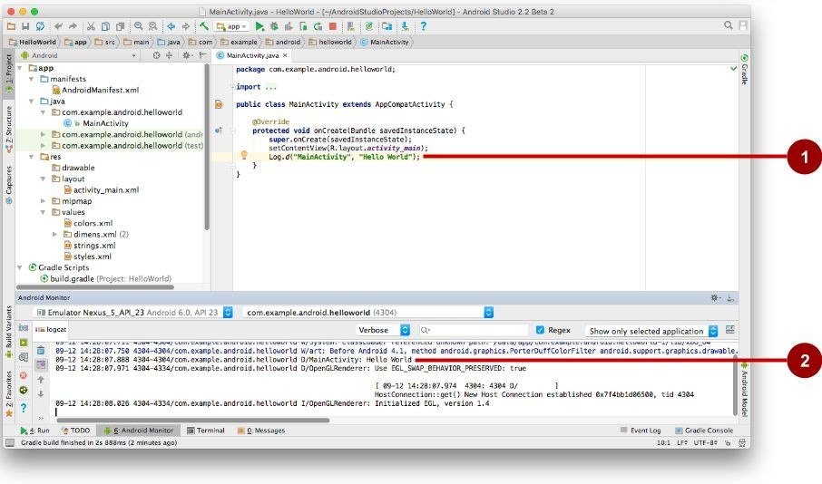
Android Monitor > logcat pane
Log statements in code.
logcat pane shows system and logging messages
Set ﬁlters to see what's important to you
Search using tags

Slide 25
Learn more
Meet Android Studio
Oﬃcial Android documentation at developer.android.com
Create and Manage Virtual Devices
Supporting Different Platform Versions
Supporting Multiple Screens

Slide 26
Learn even more
Gradle Wikipedia page
Google Java Programming Language style guide
Find answers at Stackoverﬂow.com

Slide 27
What's Next?
Concept Chapter: 1.1 C Create Your First Android App
Practical: 1.1 P Install Android Studio and Run Hello World

Slide 28
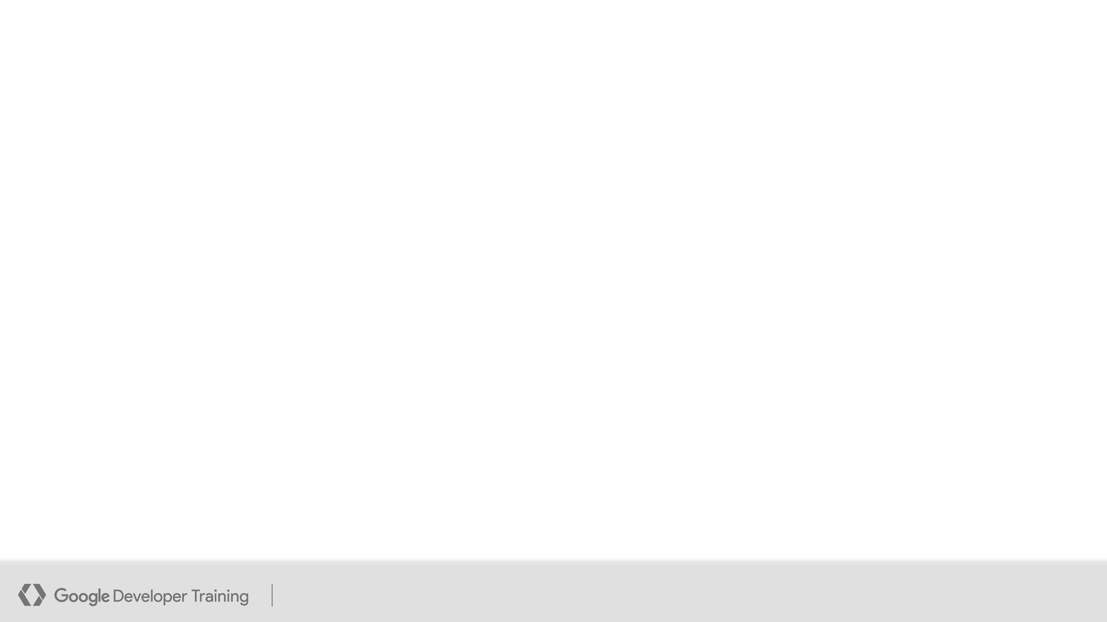
END
This work is licensed under a Creative
Storing Data Commons Attribution-NonCommercial
4.0 International License
Android Developer Fundamentals
28

